Slide 1


FGH INTRODUCTION

Slide 2
DIGITAL CAPABILITIES
HR PORTAL ENROLMENT PORTAL CLAIMS PORTAL
MOBILE APP

Slide 3
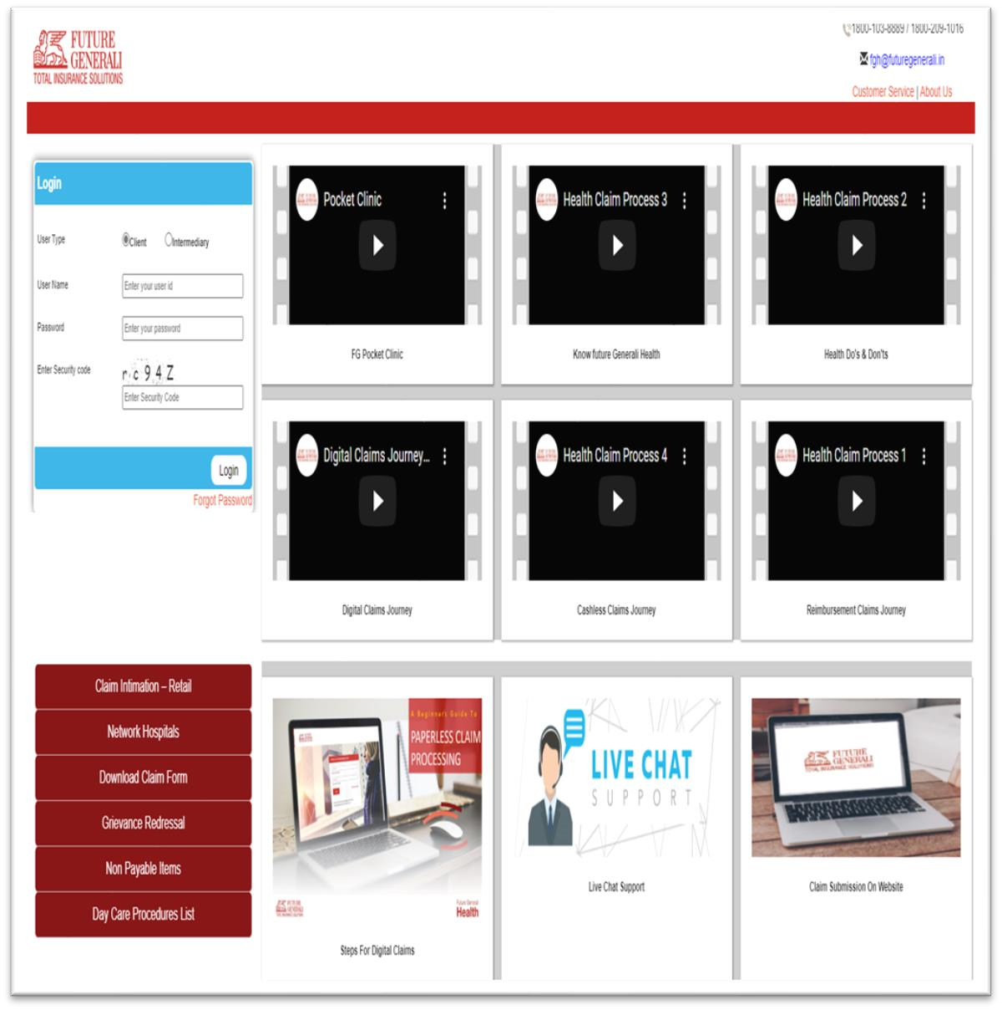
DIGITAL PORTAL
11
Features of FG Digital Portal
Portal Link :- https://healthbuzzportal.futuregenerali.in
Claim Intimation
Claim Registration
Track Claim
Download E-card
List of Network
Hospitals
Other information's

Slide 4

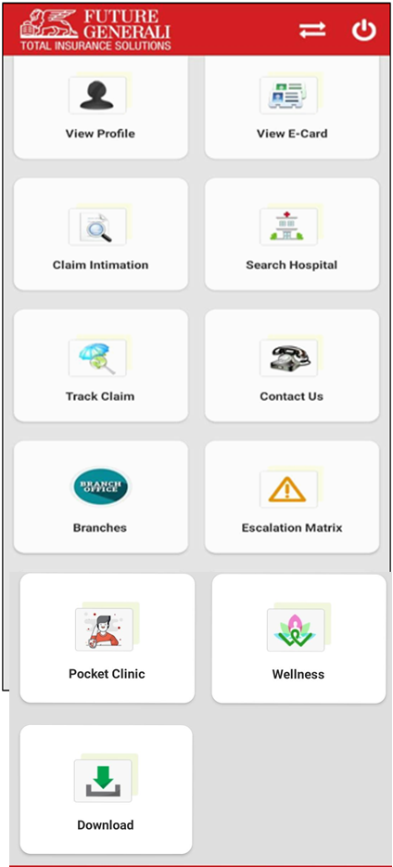



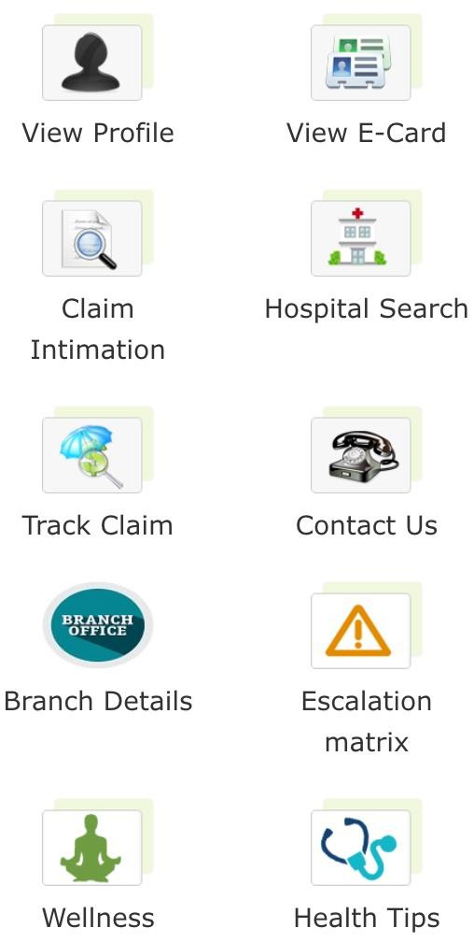
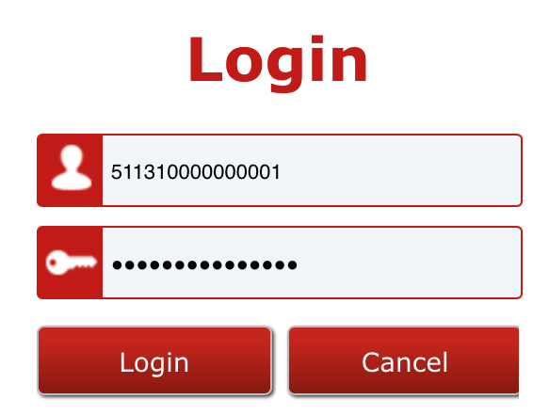


FGH MOBILE APP
12
Customers can view their profile along with the list of all enrolled dependents.
Customers can view and download the Health Card for all enrolled members.
Customer can view the updated list of all Network Hospitals
Customer can intimate a claim online anytime.
Customer can track the claim status online.
Customers can view the department wise contact information.
Customers can view the contact information of FG offices across
Customers can view FGH escalation Matrix.
Customer can access the Pocket Clinic for Teleconsultation.
Customer can download
processes, claim form,
Pre Auth form, Day care list etc.
Copyright@2016. Future Generali. All Rights Reserved.
Insurance is the subject matter of solicitation.
Confi
den
tial Future Generali India Insurance Company Limite
d

Slide 5
FGH CLAIM
& Enrollment Process

Slide 6
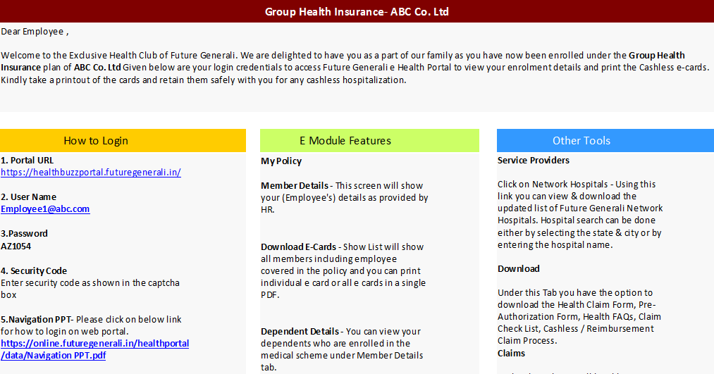
Employee Communication about Insurance coverage

Slide 7
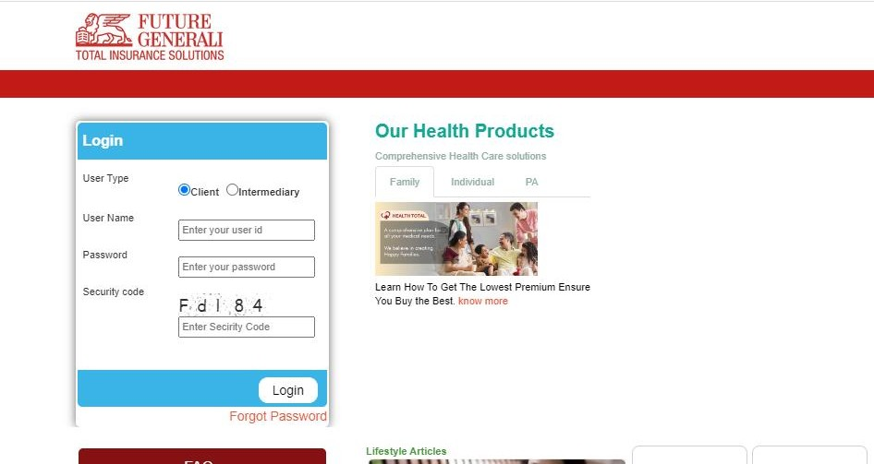

User Login Page
Web Link - https://healthbuzzportal.futuregenerali.in/
Click on Portal URL as shared by Future Generali.
Select “Client”
Enter User Name & Password as provided by Future Generali via welcome emailer from noreply.fgh@futuregenerali.in
Enter Security Code..
Click on ‘Login’ button to
access the web portal.
* Incase you get captcha mismatch error, please refresh the page to get another security code.

Slide 8
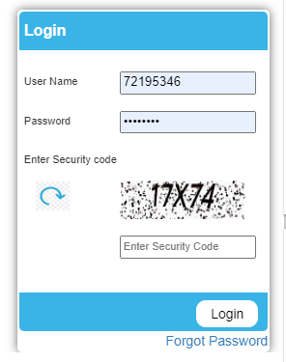
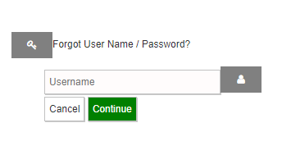
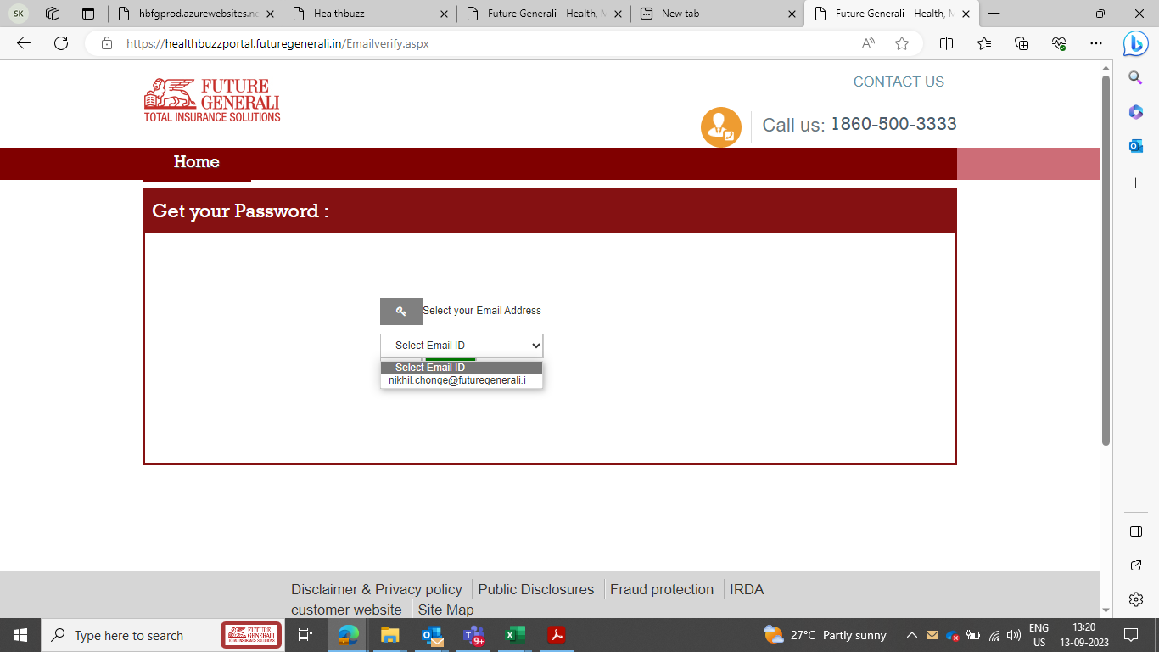

Re-set the Password
Details will be triggered to your Registered email id
In case you are unable to remember the username, you can reach out to FG.Health@futuregenerali.in

Slide 9
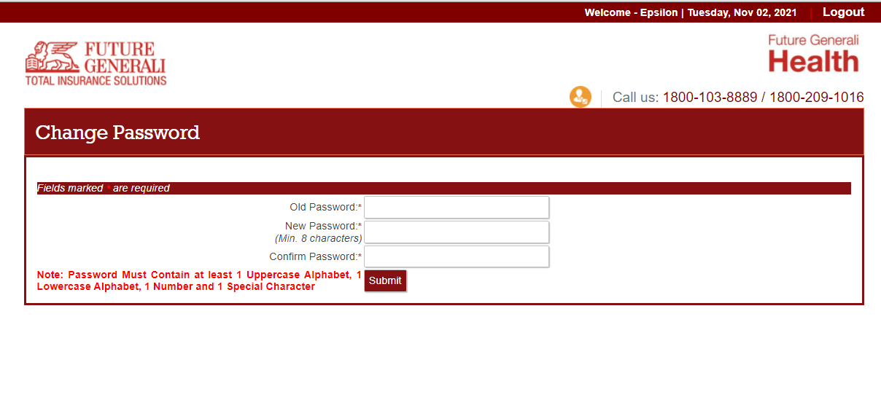
Please change your password after first login

Slide 10
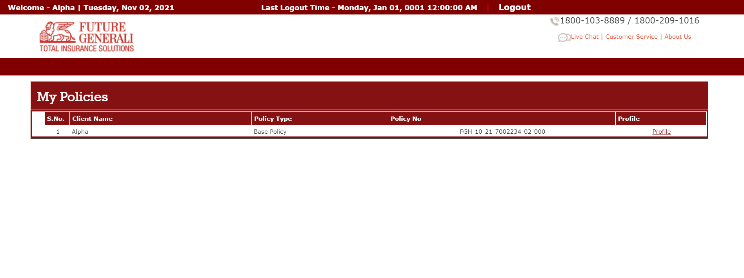

VIEW MY POLICY
Click on Profile button

Slide 11
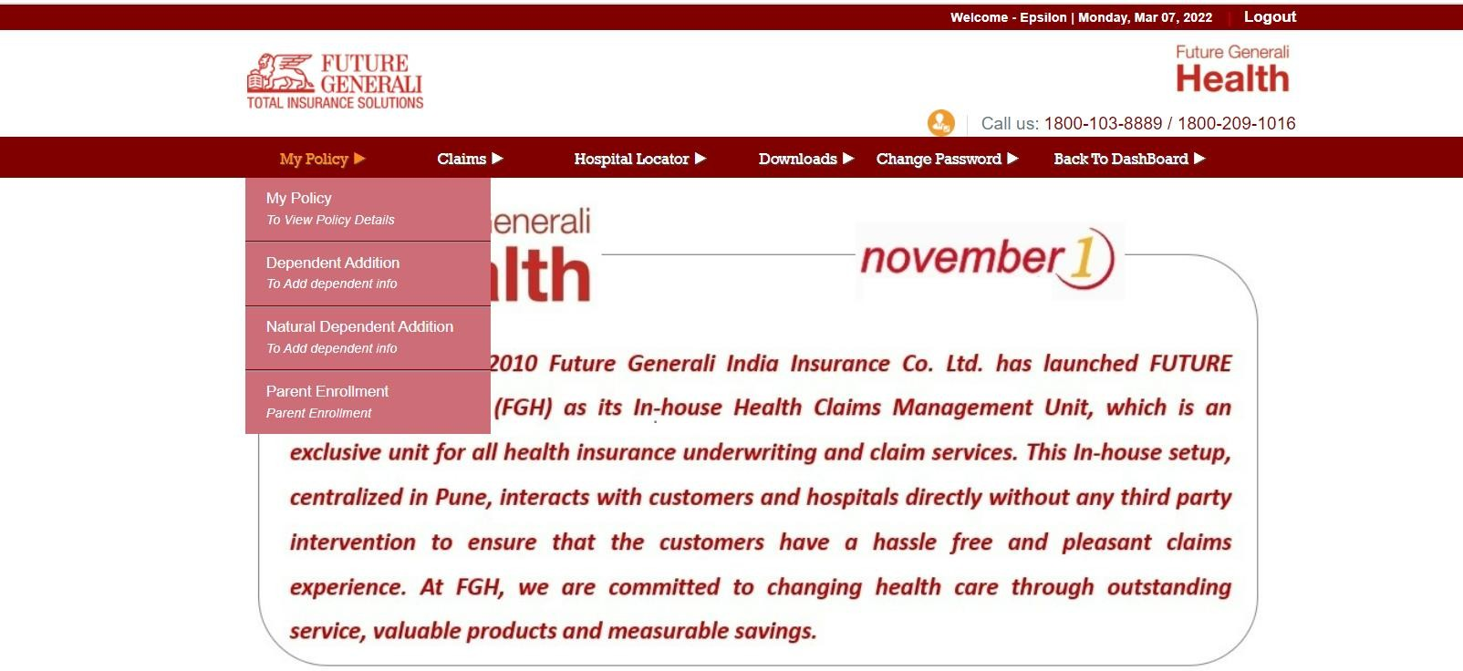
VIEW MY POLICY

Slide 12
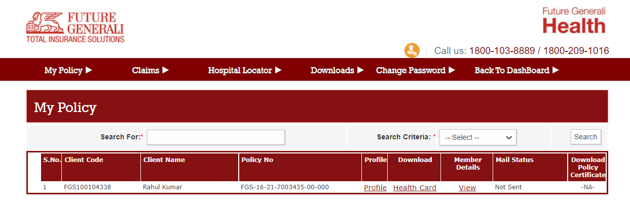
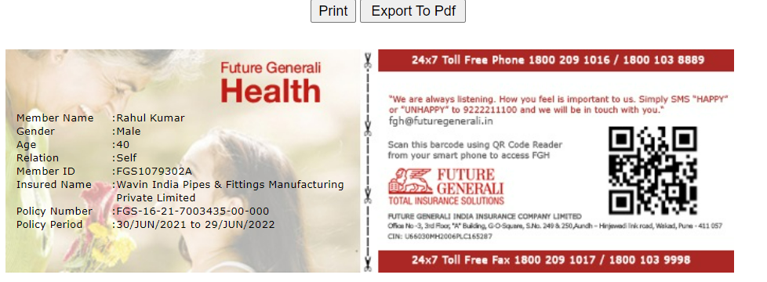
Download E-Cards (After window period is over)
Click on My Policy Tab then you can view your dependant members
By clicking on Health Card under “Download” section you will download E-Cards for your dependant members
By clicking on “Export to PDF” you can save it for your future reference.

Slide 13

Hospitalization Claim

Slide 14
Reimbursement
Claims

Slide 15
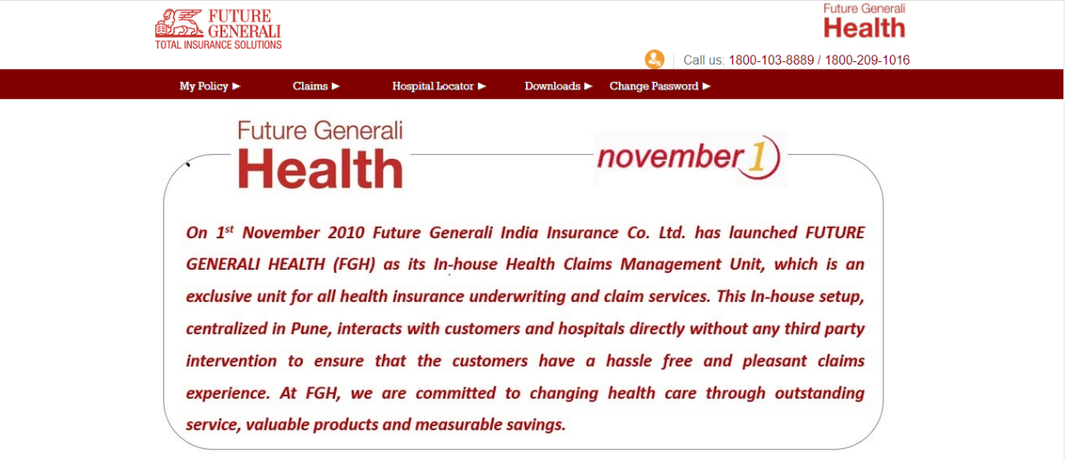
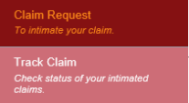
Claim Registration Process
Next
Step 1 : Click on “Claim Request” option which is under the tab “Claims”.

Slide 16
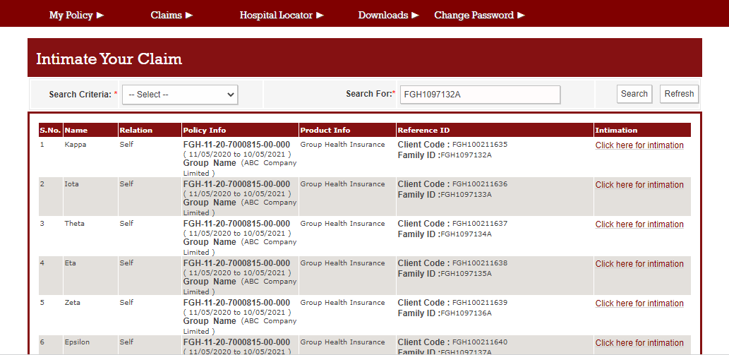
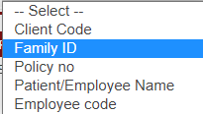
Claim Registration Process
Step 2 : Select “Family ID” from options available in “Search Criteria” field and then enter Family id in “Search For” field. Then click on “Search” button to get the records.

Slide 17
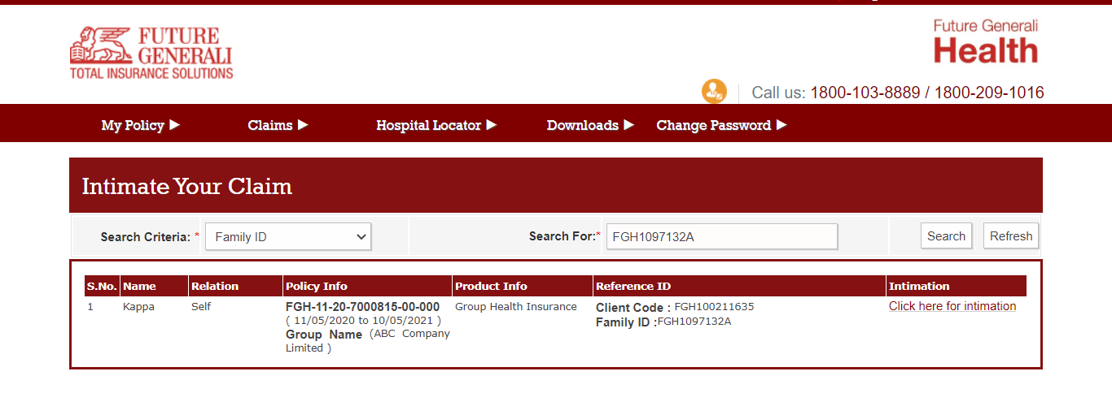
Claim Registration Process
Step 3 : Click on “Click here for Intimation” link which is in front of member to whom we want to raise a claim.

Slide 18
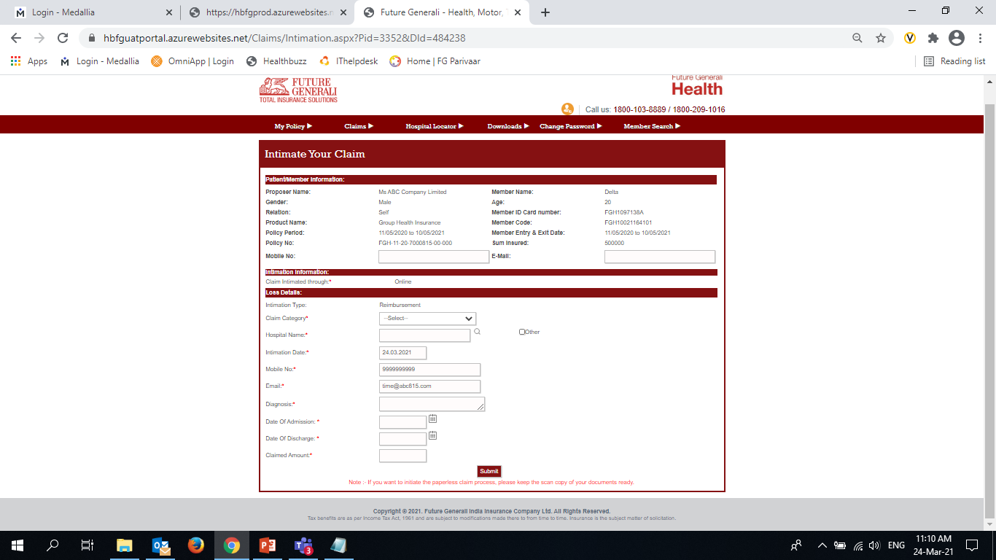
Claim Registration Process
Step 4 : Fill all the details in “Loss Details” column and then click on “Submit” button. You will get the claim number.
Fields to be filled for claim registration -
Claim Category
Hospital Name
Mobile No
Email
Diagnosis
Date of Admission
Date of Discharge
Claimed Amount

Slide 19
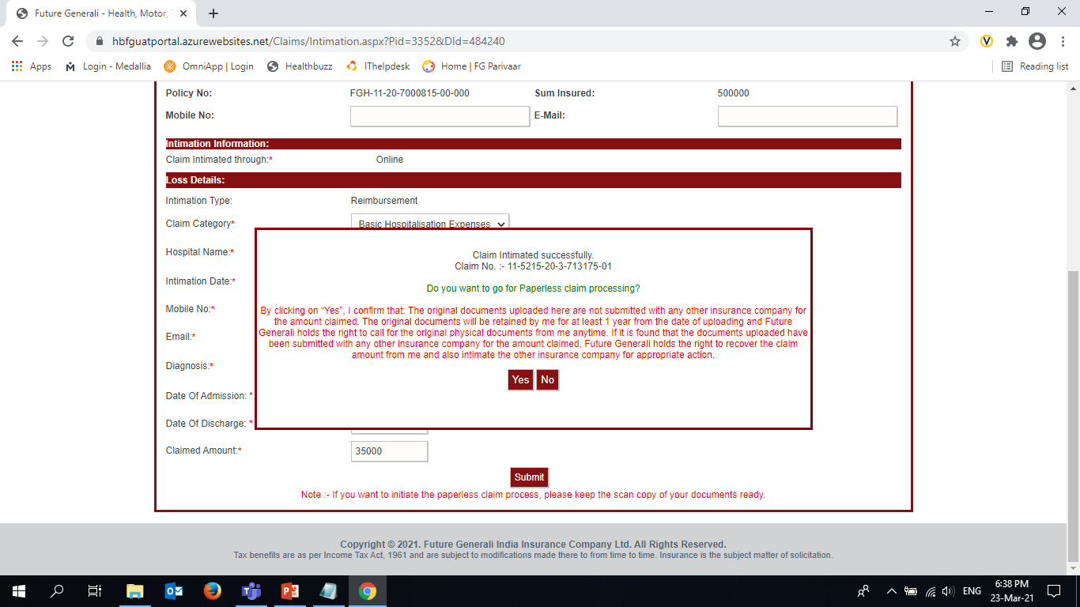
Claim Registration Process
Post claim registration, you will get an option to proceed for paperless processing.
If you have scanned copies of claim documents ready with you, then you can click on “Yes” button to proceed.
If you do not have claim documents, then you can click on “No” and submit physical copies of documents at FGH address.

Slide 20
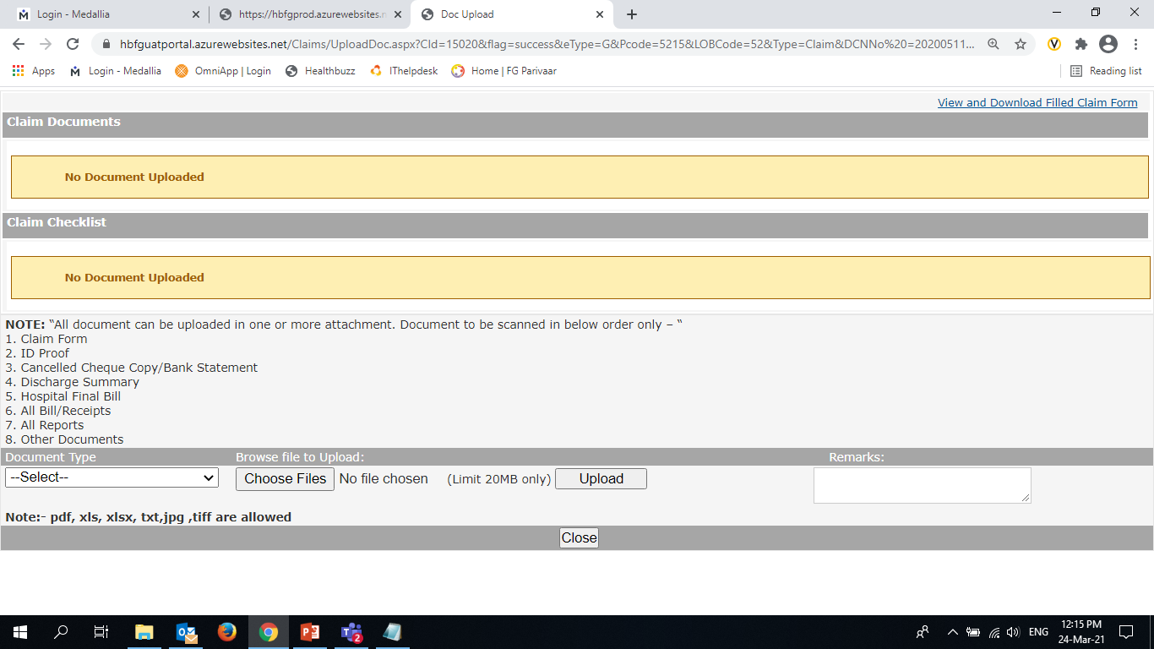
Document Upload Process
Select any option from “Document Type” and then tick list of documents which are going to upload.
Then, click on “Choose Files” option under Browse file to upload option and then select the attachment. Then click on “Upload” to upload the documents.

Slide 21
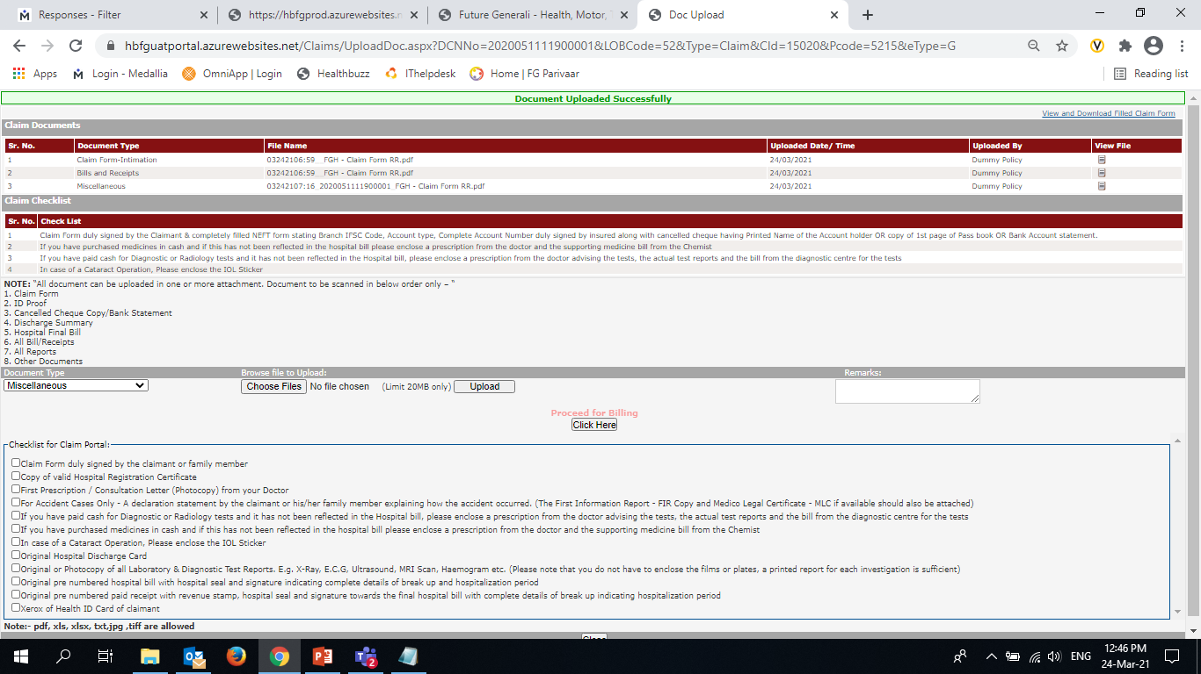
Claim Billing Process
Step 5 : Click on “Proceed for Billing” button to enter bill details in the claim.

Slide 22
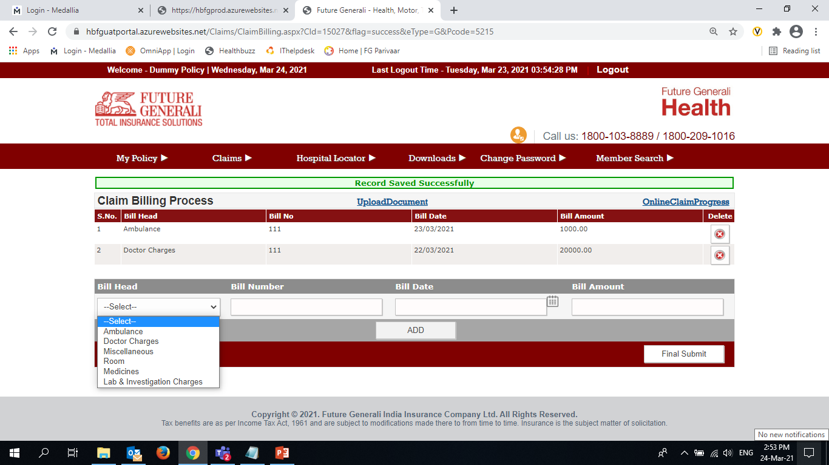
Claim Billing Process
Step 6 : Enter all the bill details and then click on “Final Submit” button. Once you click on this button claim process will be completed.

Slide 23
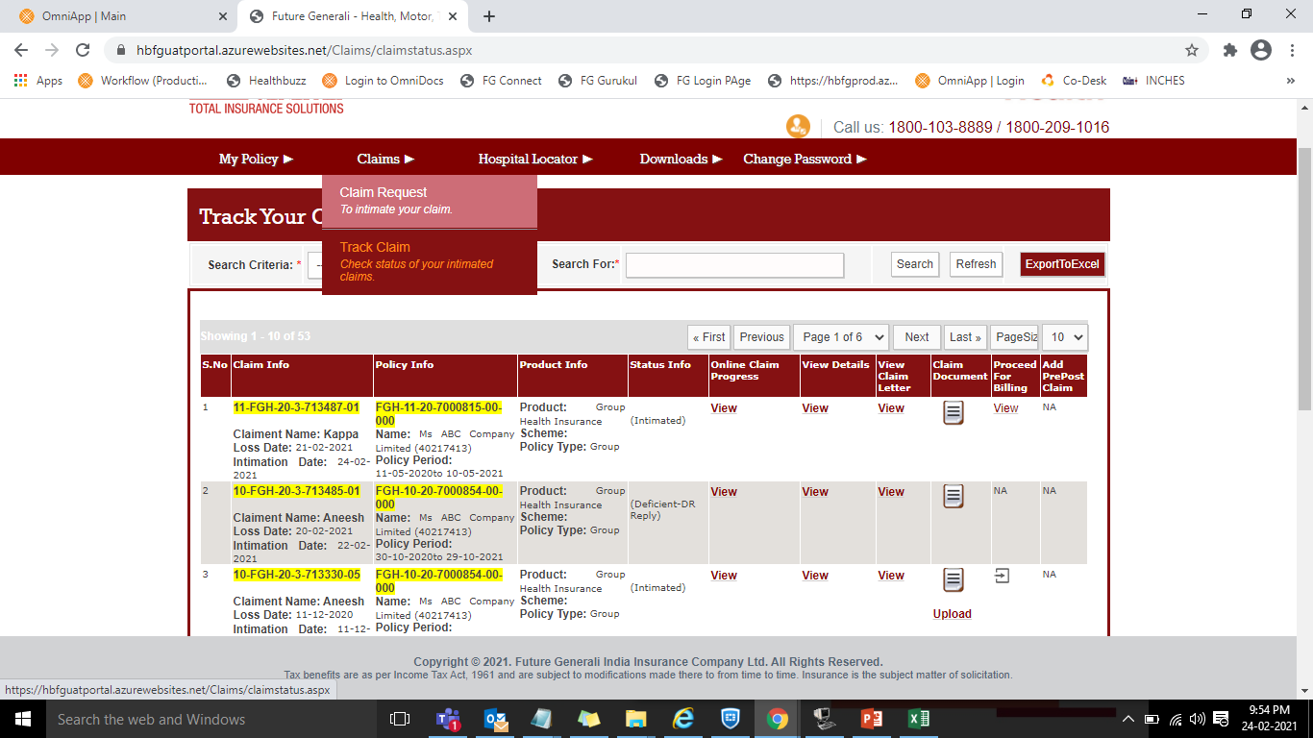
Claim Tracking
Please select “Track Claim” option which is under the tab “Claims” to view the claim details.

Slide 24

How To Avail Cashless when cards are not available

Slide 25
while the policy is in the process of issuance, employees can still avail of cashless benefits even in the absence of E-cards. If a member requires cashless services, they can approach the TPA desk at any of our network hospitals. They will need to provide their Employee No and corporate name, and state that the policy issuance is underway.
Our team has access to all the data shared on day one for the quote, and they will process the cashless request upon receipt. You can check our network hospital list here.
- https://general.futuregenerali.in/hospital-locator

Slide 26
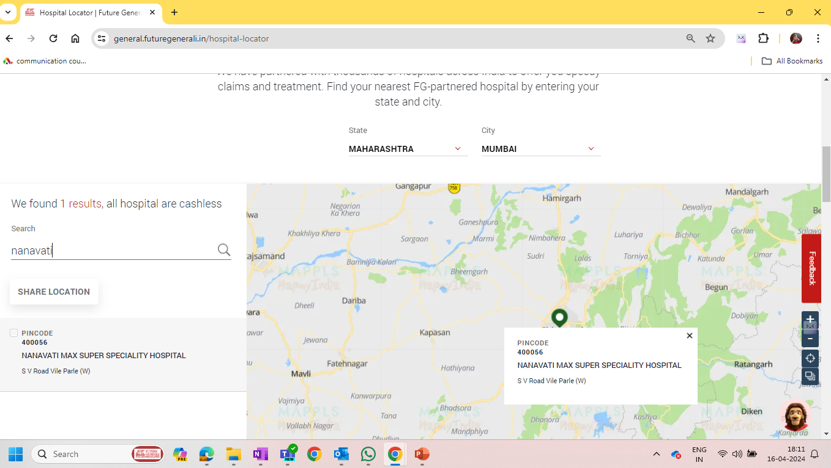

Slide 27
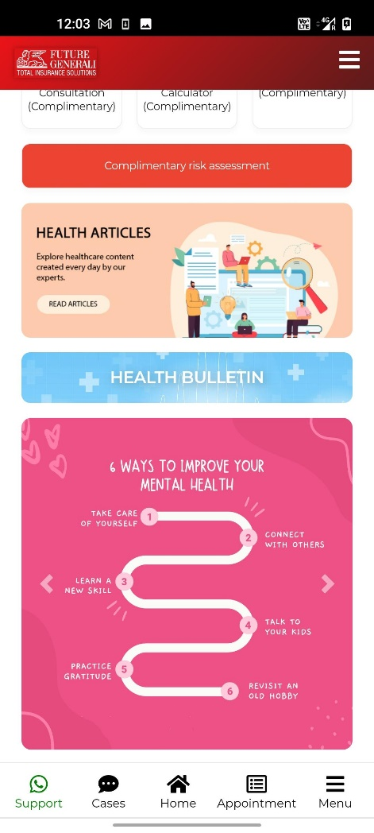

product
Tele-Consultation
Covid-19 Consultation
Second Opinion Consultation
Risk Assessment
Nutritional Consultation
Fitness Sessions
Dental Care Consultation
Calorie Calculator
Diagnostics services
DISCOUNTED
E-Pharmacy services
Home care
Mental care
FREE & UNLIMITED
OTHERS
Health Infographics
Health Blogs

Slide 28
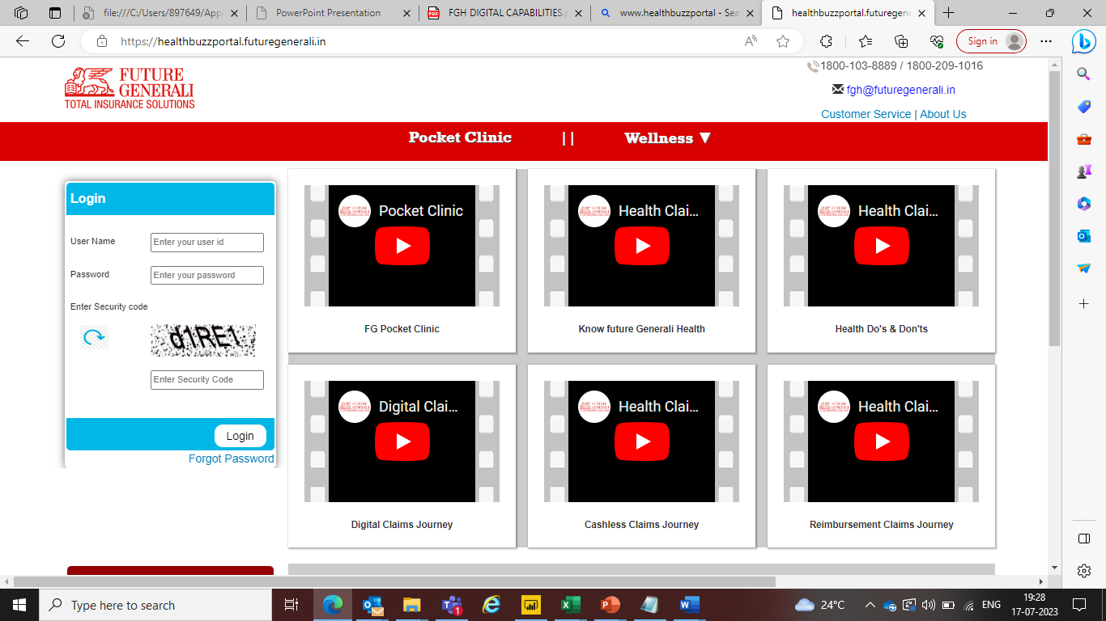
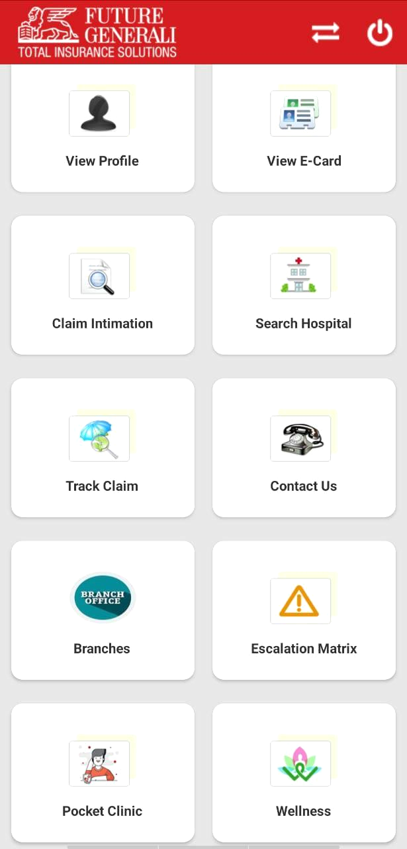
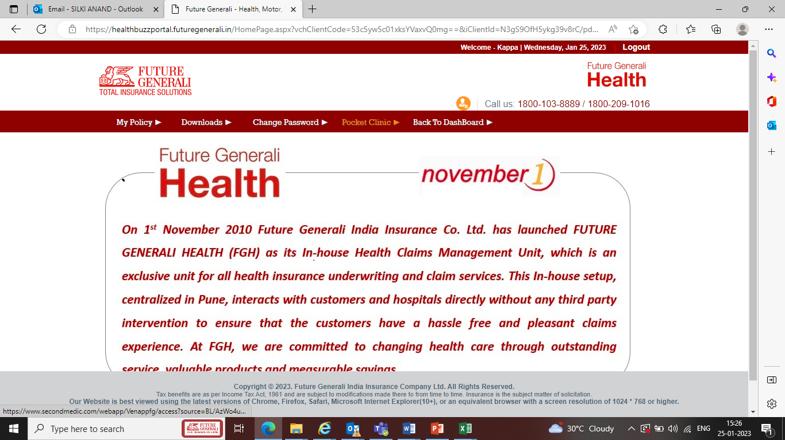

TECH INTEGRATION

Slide 29
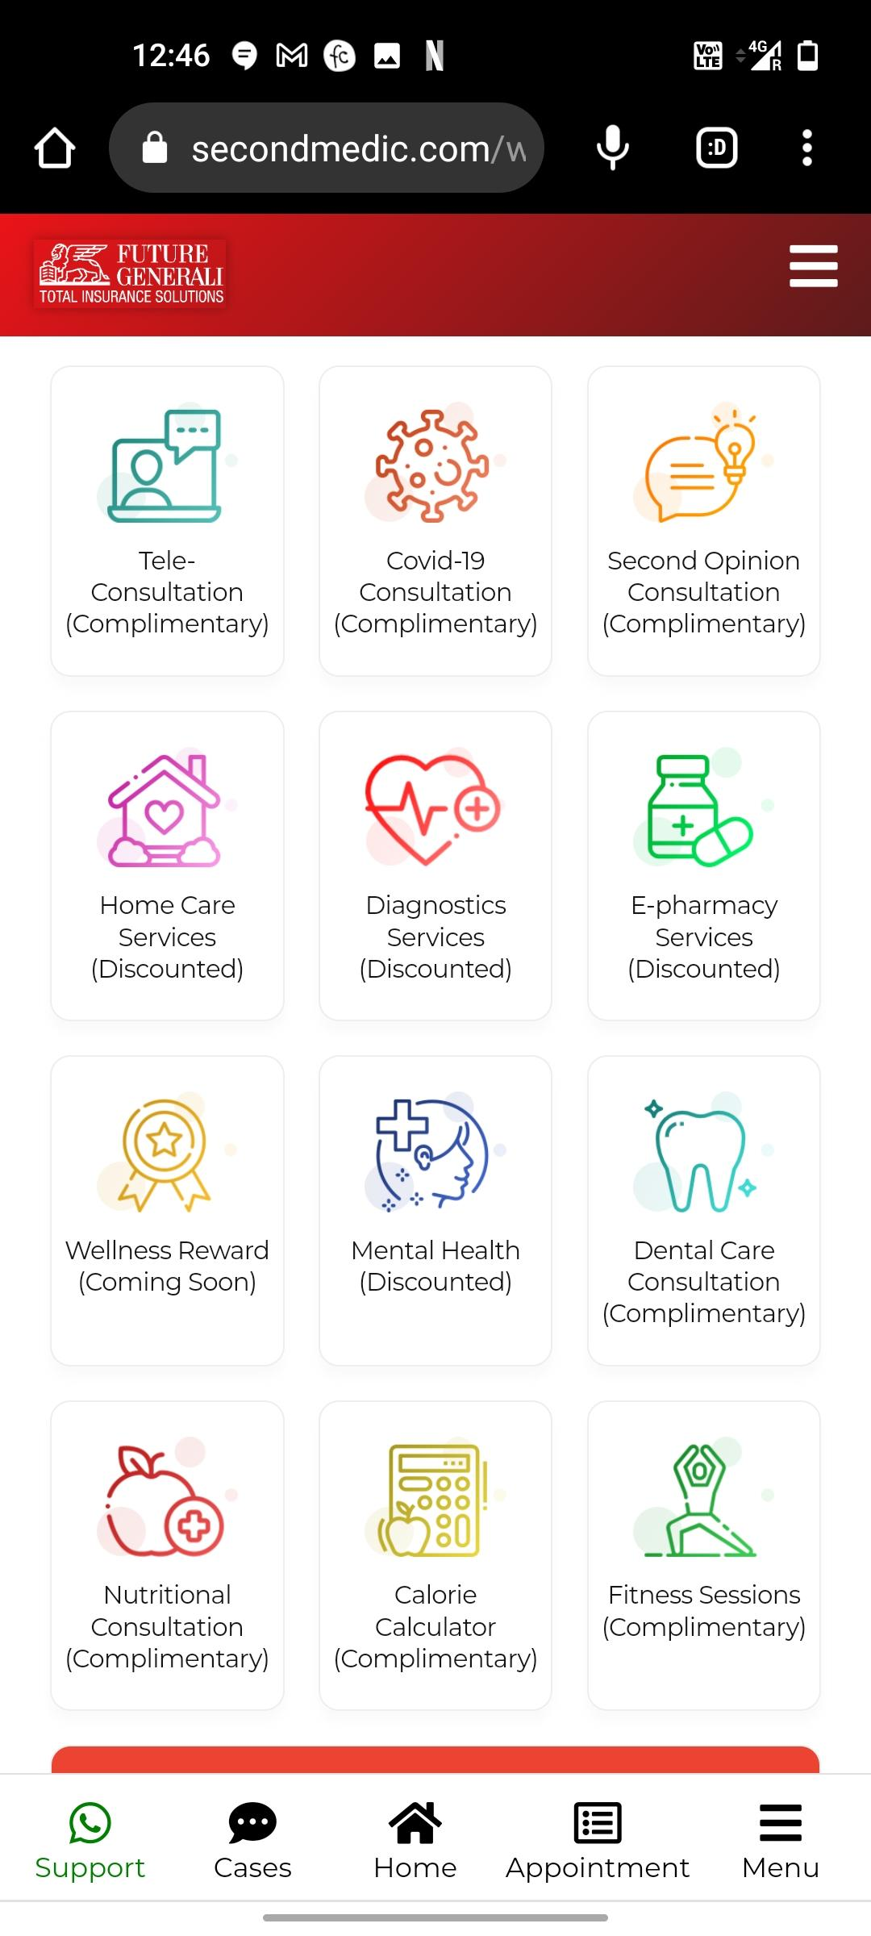
HOW TO BOOK AN APPOINTMENT

Slide 30
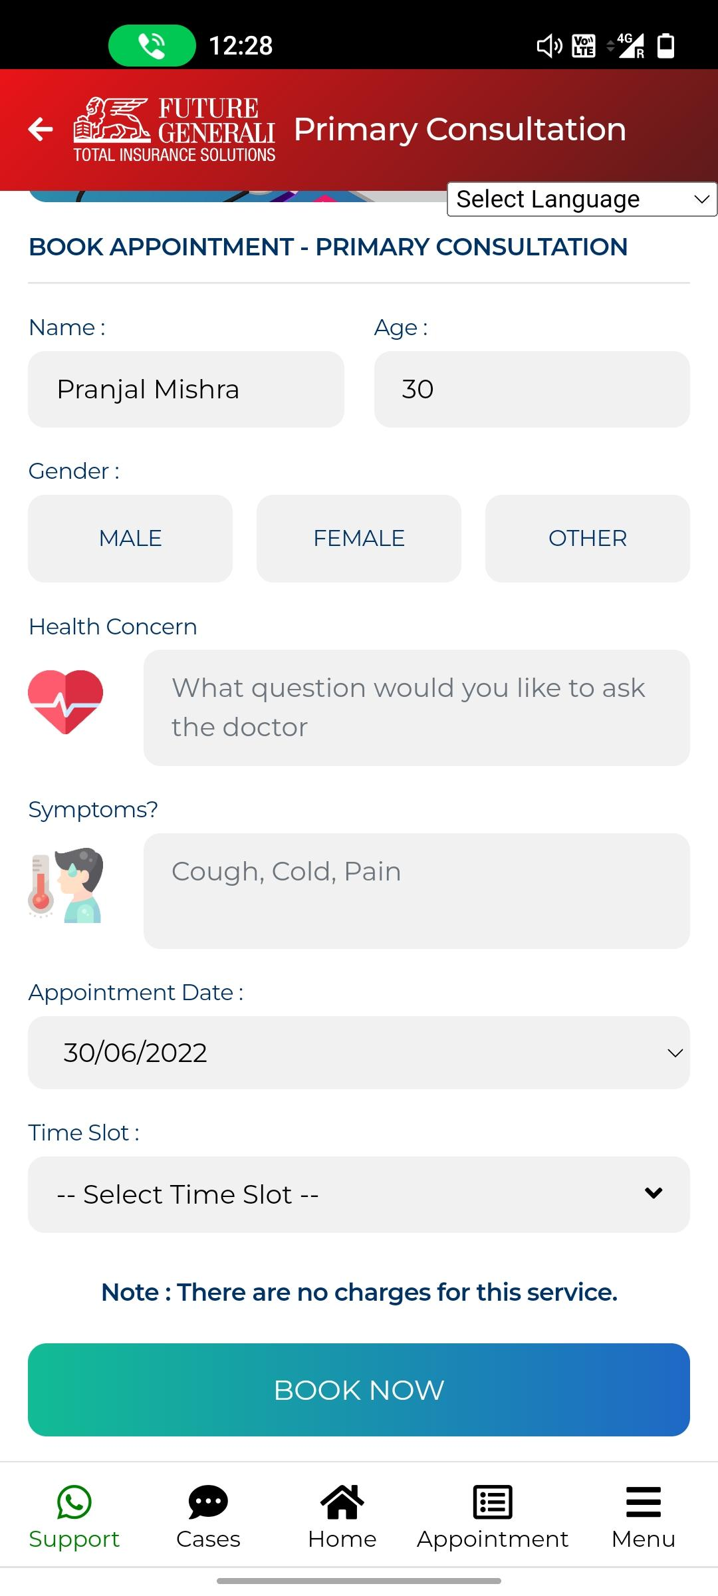
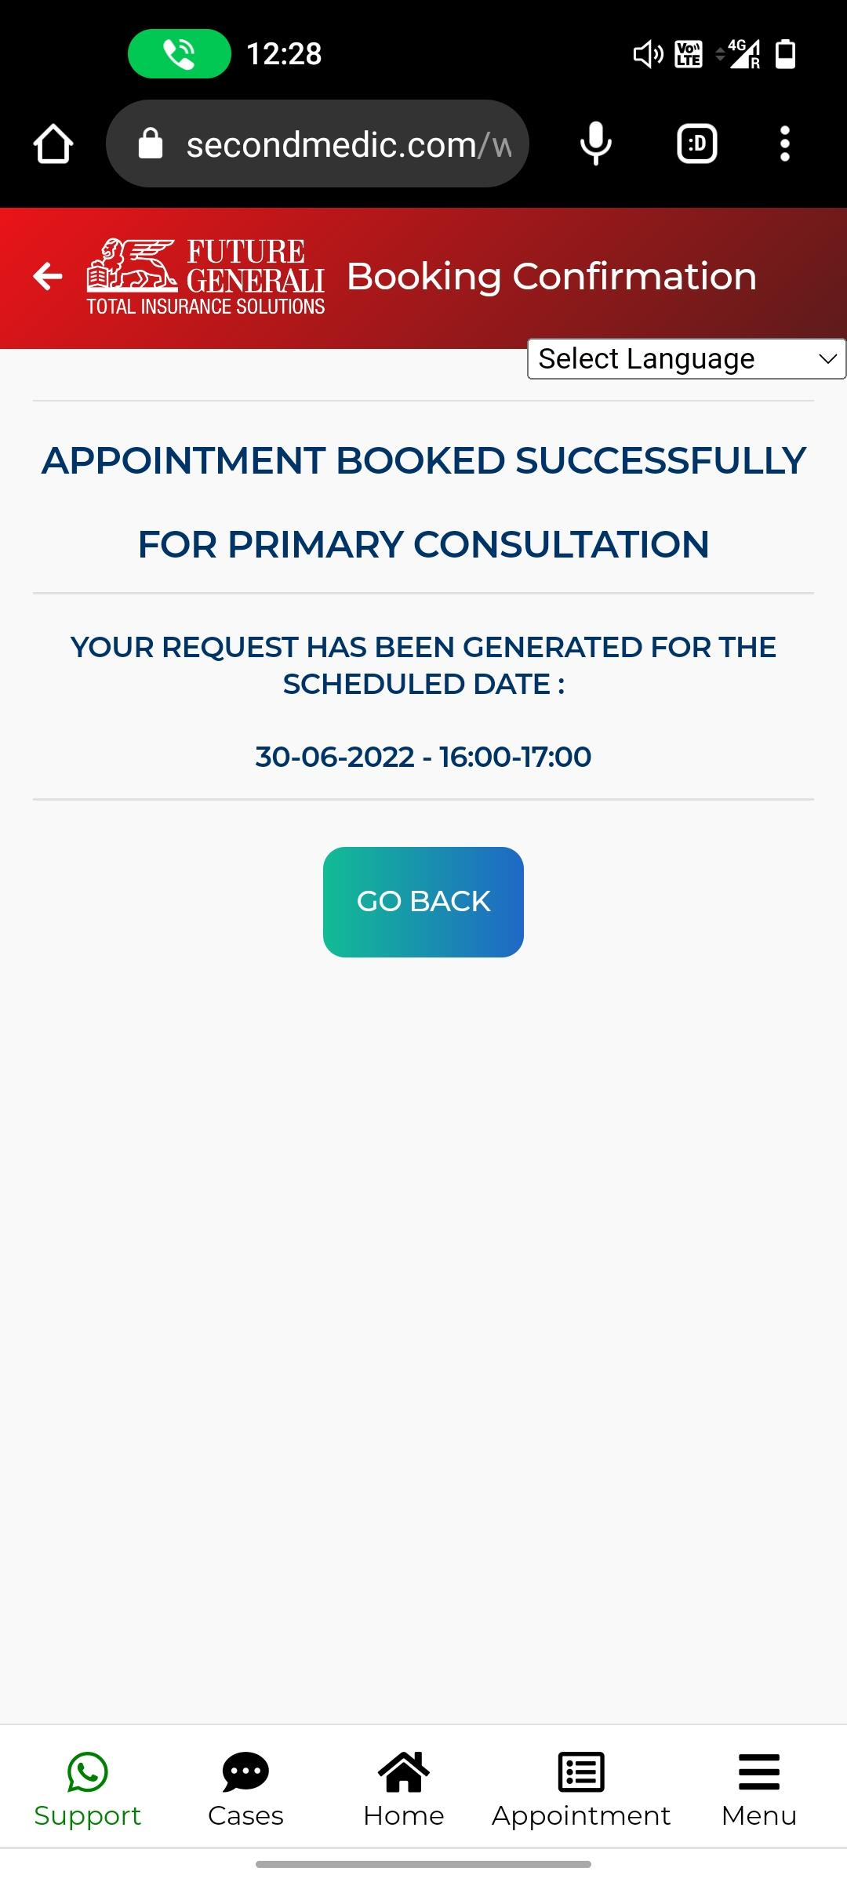
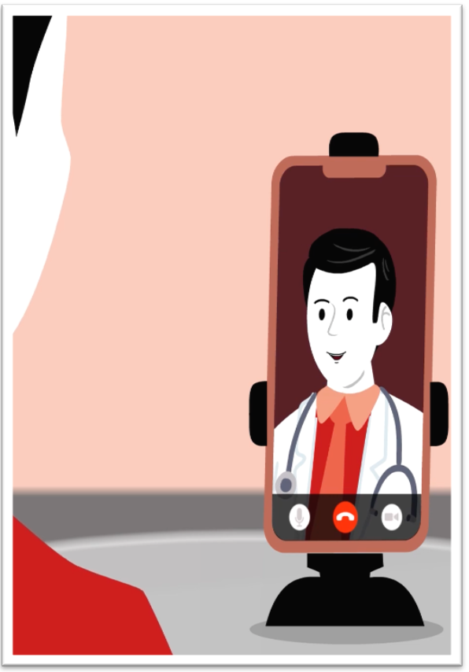
Enter purpose of consultation and other details
Get appointment confirmation
Talk to the doctor as per appointment booked

Slide 31
Important Links
FGH Digital Portal
Daycare List
Network List
FG Digital Claim Guide
Non Payable Item list
Download Claim Form
Click on the link to access the following link

Slide 32
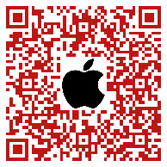

QR code for APP

Slide 33





Thank You
Online Chat
Email
Web Portal
Scan to download FGH Mobile App
Contact us :- 1800 209 1016 / 1800 103 8889 (Health - Phone)

